Slide 1
Project Presentation on
BOOK RECOMMENDATION SYSTEM USING CONTENT BASED (TAG BASED)
FILTERING
Presented by:
Deeksha Arora (50385)
Maansi Bhatnagar (50387)
Rakshita Joshi (50388)

Slide 2
CONTENTS
Introduction
Motivation
Classification of Recommendation System
Problem Statement
Requirements
Methodology
Results
Conclusion
References

Slide 3
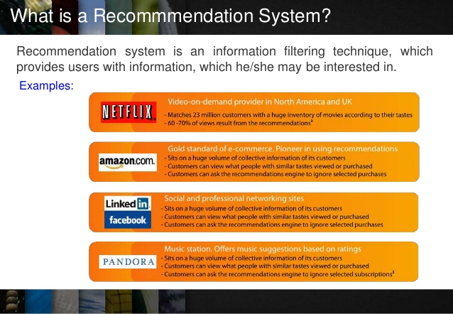
INTRODUCTION
Recommendation system is an information filtering technique, which provides users with information, which he/she may be interested in.
It aimed at suggesting relevant items to users (items being movies to watch, text to read, products to buy or anything else depending on industries).
EXAMPLES:-

Slide 4
MOTIVATION
help the user to get personalized recommendations
helps users to take correct decisions in their online transactions
increase sales and redefine the users web browsing experience
retain the customers
enhance their shopping experience.

Slide 5
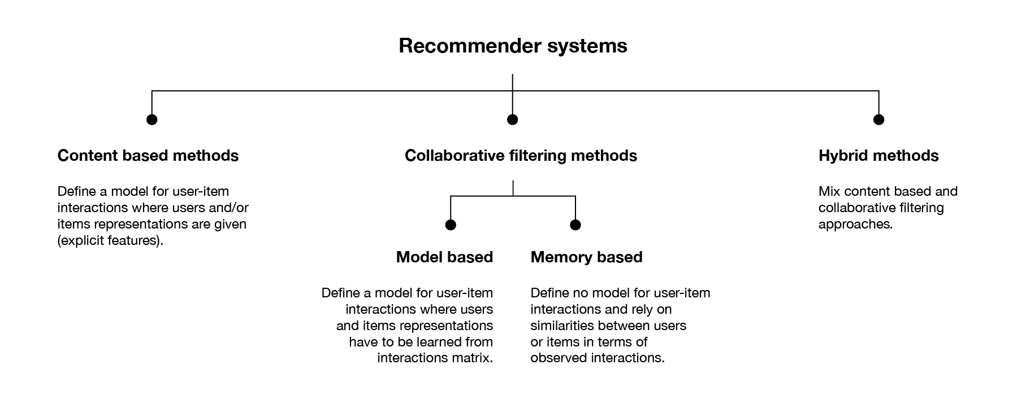
Classification of Recommendation System

Slide 6
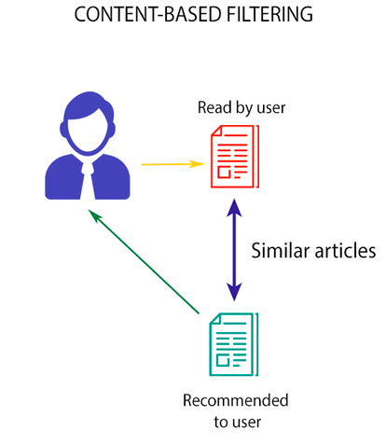
CONTENT BASED FILTERING
recommend items similar to those a user has liked (browsed/purchased) in the past.
OR
Recommendations are based on the content of items rather on other user's opinion

Slide 7

COLLABORATIVE FILTERING
finds a subset of users who have similar tastes and preferences to the target user and use this subset for offering recommendations
Main Approaches :
- Memory based
- Model based

Slide 8
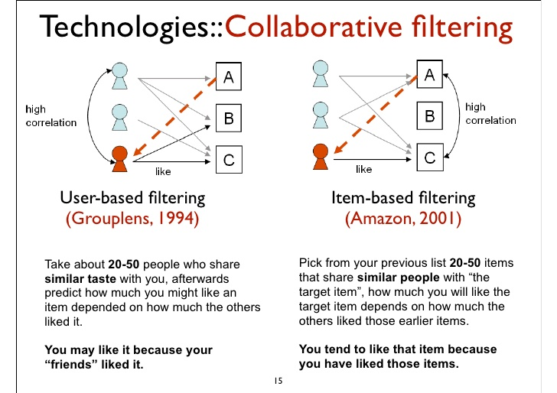
MEMORY BASED
The main characteristic of this approach is that they use information only from the user-item interaction matrix and they assume no model to produce new recommendations.

Slide 9
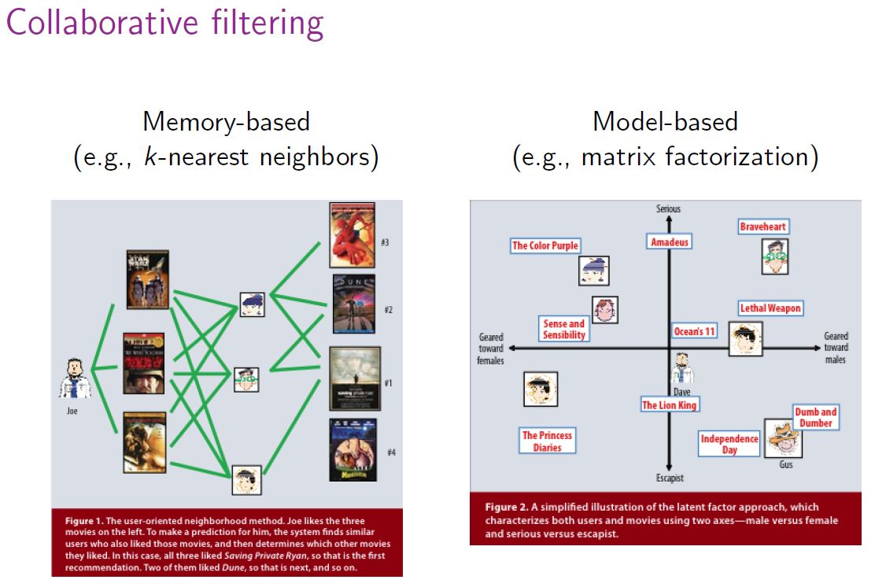
MODEL BASED
only rely on user-item interaction information and assume a latent model supposed to explain these interactions

Slide 10
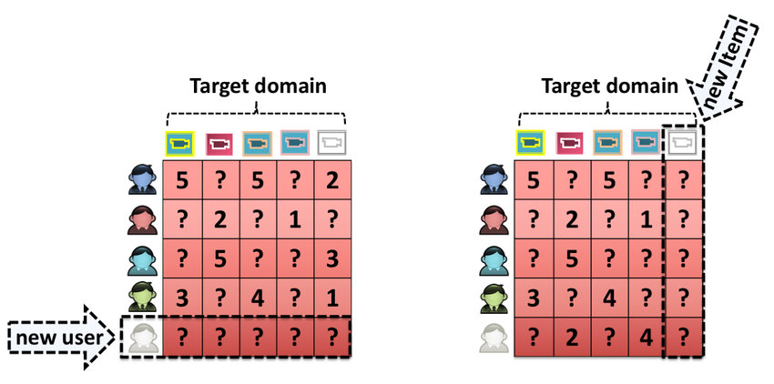
COLD START PROBLEM
SOLUTION :- RANDOM STRATERGY

Slide 11
PROBLEM STATEMENT
Given some datasets ( books, ratings, tags, booktags, to read ) we develop A Book Recommendation System using:-
Content Based Filtering (Tag Based)

Slide 12
REQUIREMENTS
Software Interfaces
1. Microsoft Word 2016
2. Database - My SQL 5.6
3. Operating System: Windows10
4. Anaconda 3
Hardware Requirements:
1. i5 Processor Based Computer
2. 4 GB-Ram(Atleast)
3. 100 GB Hard Disk(Atleast)

Slide 13
CONTENT BASED MODEL

Slide 14
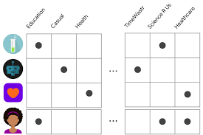
UNDERSTANDING THE CONCEPT
Content-based filtering uses item features to recommend other items similar to what the user likes, based on their previous actions or explicit feedback.
Some of the user-related features could be explicitly provided by the user. For example, a user selects "Entertainment apps" in their profile.

Slide 15
STEPS INVOLVED
LOAD THE DATA
USING COSINE SIMILAIRTY TO CALCULATE SIMILARITY SCORE
RECOMMENDING BOOKS TO USER
COUNT VECTORIZATION
CONVERTING LIST TO STRING

Slide 16
CONVERTING LIST TO STRING
In order to be able to properly perform content based filtering, first we have to put all the tags related to one single book in a single string: each tag must be separated from each other with a space, to be accounted as a single word.

Slide 17
COUNT VECTORIZATION
In order to use textual data for Content based modeling, the text must be parsed to remove certain words – this process is called tokenization. These words need to then be encoded as integers, or floating-point values, for use as inputs in machine learning algorithms. This process is called feature extraction (or vectorization).
CountVectorizer is used to convert a collection of text documents to a vector of term/token counts.
It will generate a matrix in which the columns represent all the tag-words that have been included in the analysis and the rows represent the books.

Slide 18
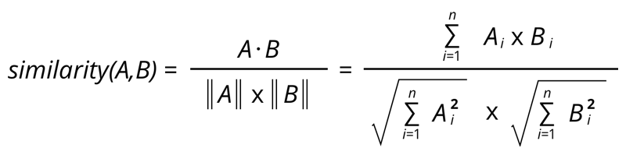
COSINE SIMILARITY
Cosine similarity is a metric used to determine how similar the documents are irrespective of their size.
Mathematically, it measures the cosine of the angle between two vectors projected in a multi-dimensional space.

Slide 19
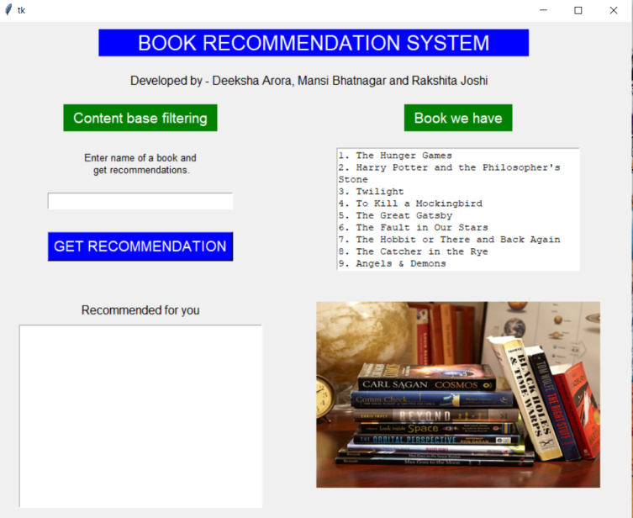
RESULTS
User visits the Desktop app where he/she can select a book of his/ her choice from a list of books.

Slide 20

User enters the book of his choice and Clicks on “Get
Recommendation" button

Slide 21

Books are
recommended to the user.

Slide 22
CONCLUSION
The goal of most of the recommendation systems is to predict the reader’s interest and recommend the books accordingly. This book recommendation has considered many parameters like content of the book, author of the book and quality of the book by using content filtering of ratings by other readers. Our experience while working on this project has enhanced our skills and has contributed towards our professional and personal development.

Slide 23
REFERENCES
https://www.researchgate.net/publication/ 325792825_An_Improved_Online_Book_Recommender_System_using_Collaborative_Filtering_Algorithm
http://infolab.stanford.edu/~ullman/mmds/ch9.pdf
Stuart E. Middleton, Nigel R. Shadbolt (2004). Ontological user profiling in recommender systems. ACM Transactions on Information Systems, 54-88
http://taste.sourceforge.net/

Slide 24
THANK YOU

